Slide 1
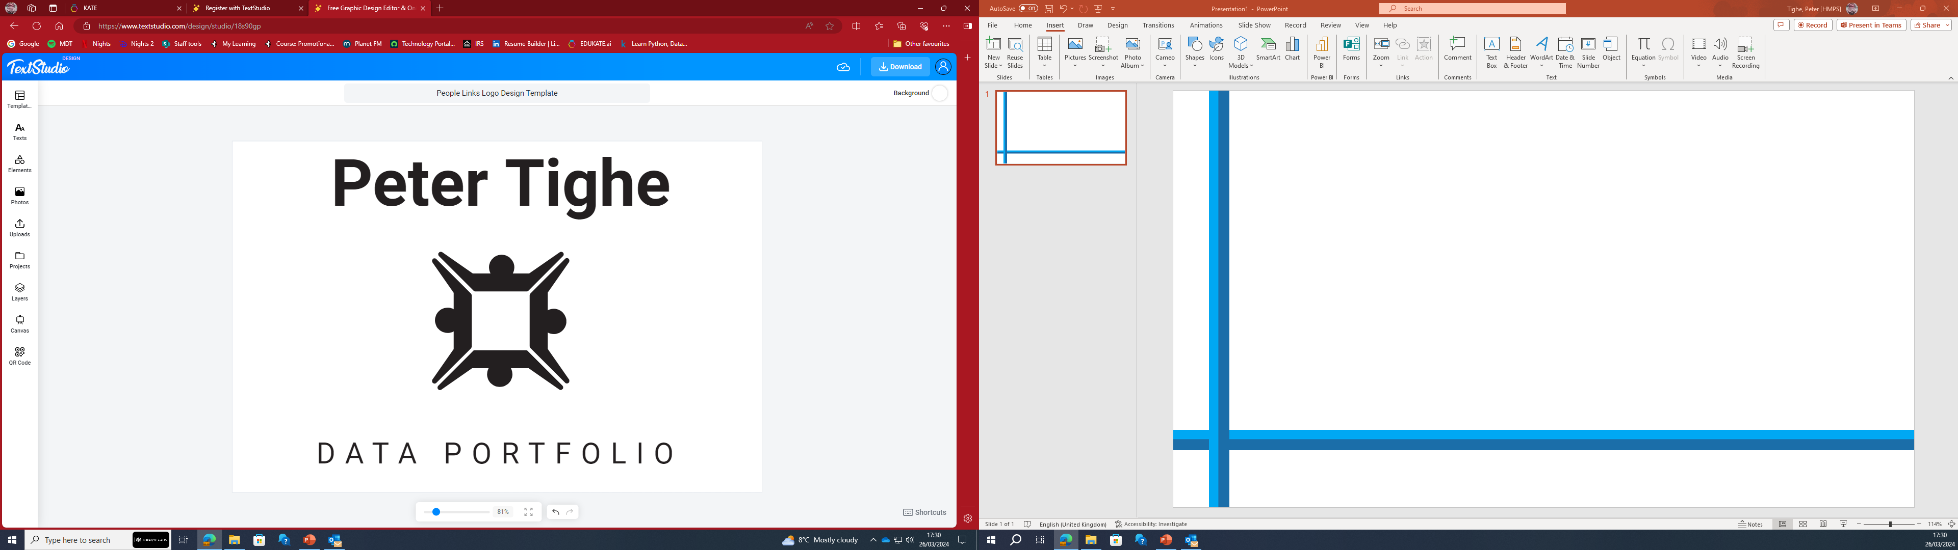

Slide 2
I am Peter Tighe, a seasoned professional with over 20 years of experience in data analysis and visualization. My journey with data began in the Royal Navy, where I honed my skills in Microsoft Excel for spreadsheet production and PowerPoint for data visualization. During my tenure, I demonstrated a steadfast dedication to utilizing data effectively, whether in collaborative team settings or through self-motivated endeavours with minimal supervision.
Transitioning to the Prison Service, I continued to leverage my expertise in data analysis to drive impactful outcomes. As a key member of the security and drug testing teams, I spearheaded initiatives aimed at identifying patterns in offending behaviour and providing insights to reduce recidivism rates. My efforts involved meticulously correlating data and presenting actionable insights to senior management, with potential implications reaching even higher governmental levels. In my role as the coordinator for the drug testing department, I took the initiative to modernize our data processing and visualization methods, improving efficiency and accuracy in reporting.
Recognizing the evolving landscape of data analysis, I embarked on a journey to further enhance my skills. I completed the Python Skills Bootcamp with Cambridge Spark and subsequently enrolled in the Applied Data Science program at World quant University. These experiences not only broadened my technical skill set but also instilled in me a passion for continuous learning and innovation.
Throughout my career, I have thrived on challenges and achieved tangible results through data-driven decision-making. For instance, I led a project to optimize drug testing procedures, resulting in a 50% reduction in processing time and a 25% increase in accuracy. Such achievements underscore my ability to translate complex data into actionable insights that drive positive organizational outcomes.
My diverse background in the Royal Navy and the Prison Service has equipped me with invaluable transferable skills, including adaptability, problem-solving, and effective communication. I am now poised to leverage this wealth of experience and technical expertise in my pursuit of a fulfilling career in data analysis.
Driven by a genuine passion for data and a commitment to excellence, I am excited about the opportunities that lie ahead. I am confident that my unique blend of experience, skills, and enthusiasm will make me a valuable asset to any team or organization in the dynamic field of data analysis.
Introduction – About me

Slide 3
PROJECTS IN THIS PORTFOLIO
PROJECT 1 :
This was a project I downloaded from Kaggle.com which provided the dataset called ‘Books.CSV’ which contained a list of books spanning from the 1800s until present, I attempted to find a correlation between popularity of author and how many books they released and to see if books would become obsolete due to digital entertainment.
PROJECT 2 :
This was a project set by Cambridge Spark during my data analyst bootcamp, I had been assigned the task of investigating differences across product lines with respect to customer characteristics. These included, Product Data, Product Usage and Gender gap, and Income Data. This was presented to my instructor and my group as if I was a member of a market research team.
Project Index

Slide 4

Data Project 1
BOOKS

Slide 5
What follows is my analysis of a dataset that I downloaded from : Popular Books Dataset (kaggle.com)
This will demonstrate my abilities and the knowledge I have picked up from my training with Cambridge Spark.
The reasoning behind choosing this dataset was to show the popularity of books as a source of entertainment and to see if there was a decline during the modern age.
The dataset contains information about popular books. Each row represents a book and includes details such as the book ID, Goodreads book ID, best book ID, work ID, number of books in the series, ISBN and ISBN13 numbers, authors, original publication year, original title, title, language code, average rating, number of ratings, number of work ratings, number of text reviews, rating counts for different rating levels (1-5 stars), and URLs for the book's image and small image.
The dataset can be useful for various purposes, such as analysing reading trends, popular authors, and book ratings across different genres or languages. It can also be used to build recommendation systems or explore correlations between book characteristics and their popularity or ratings.
Introduction – My Portfolio

Slide 6
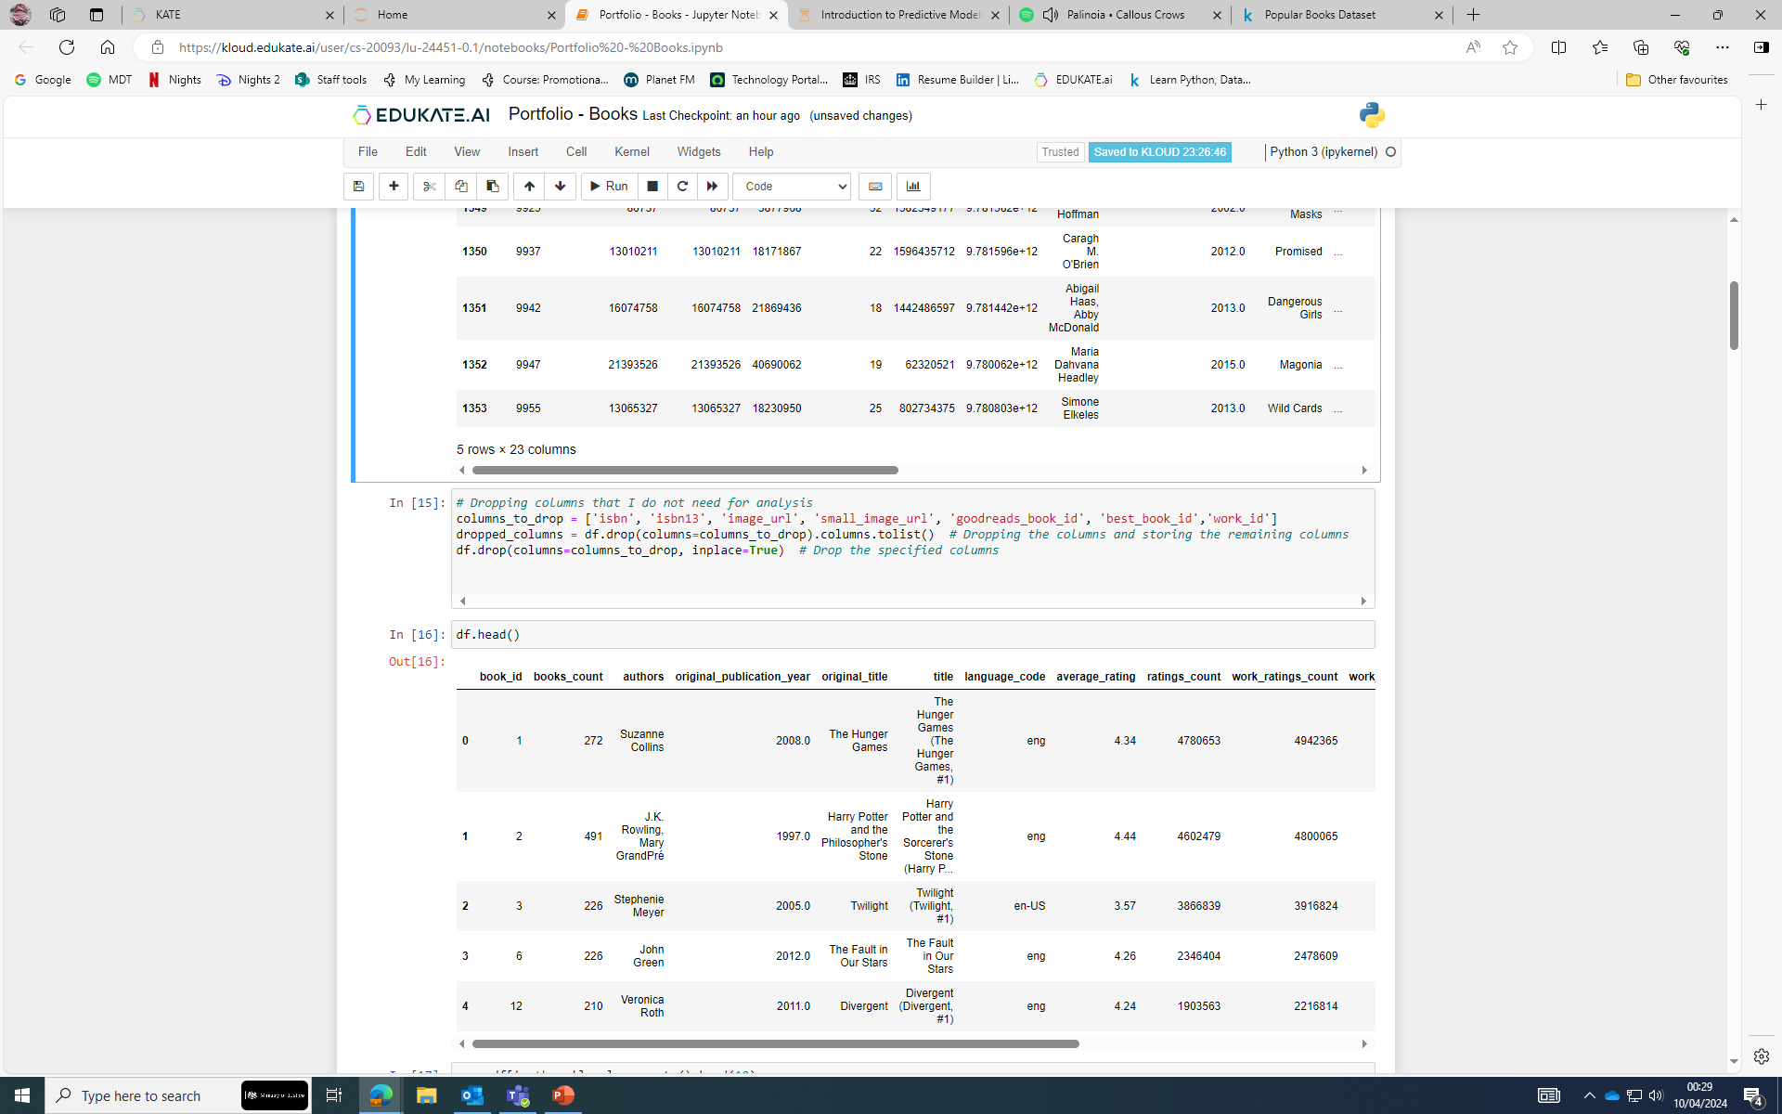
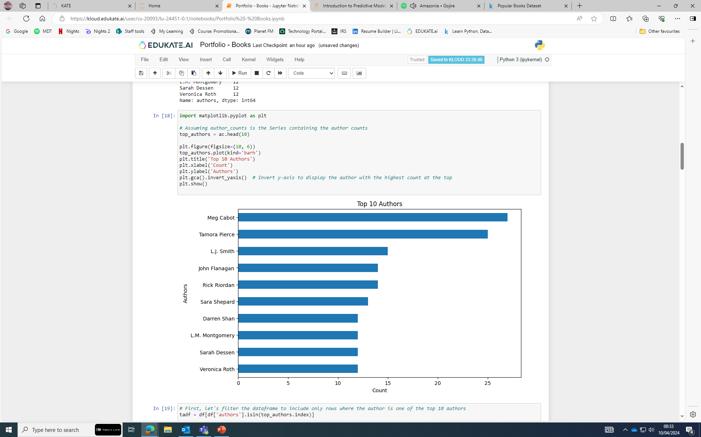
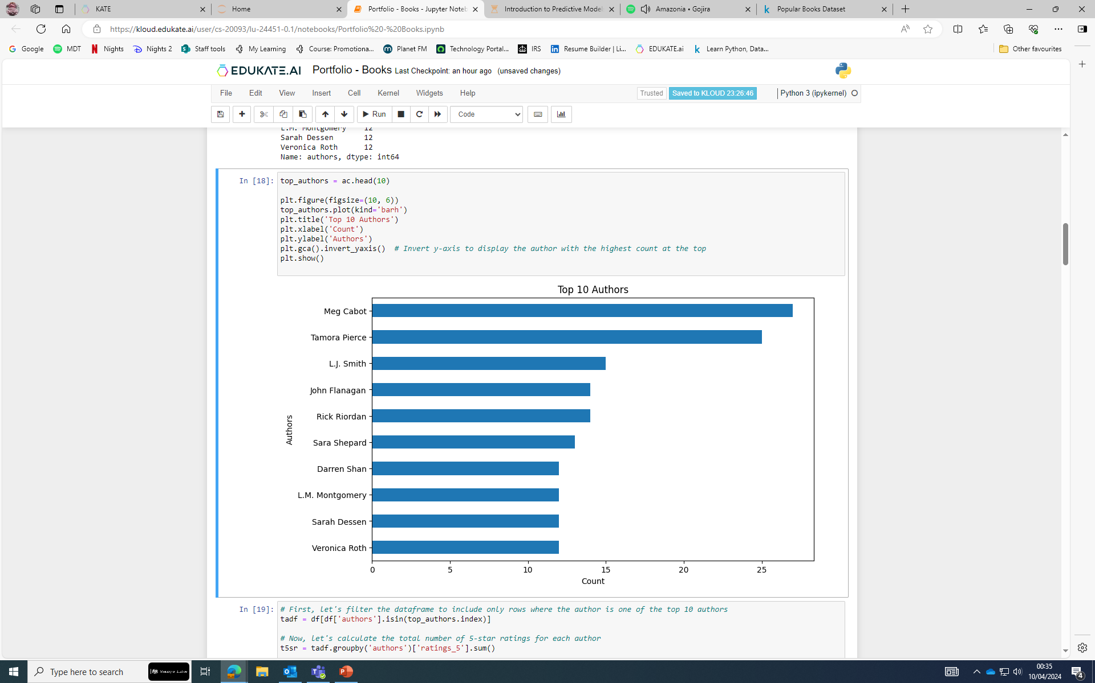
My initial analysis is used as a background picture behind this text, this gave me my first hurdle which was to drop columns and begin to correlate the relevant data I wished to show and explain. For this I dropped the following columns : 'isbn', 'isbn13', 'image_url', 'small_image_url', 'goodreads_book_id', 'best_book_id','work_id’.
The reasoning behind dropping these columns was because I wanted to attempt to show the correlation between Authors and the ratings each author had for their books.
From this I then moved on to sorting the top 10 authors by books wrote, this was easily done by using .value_counts().
This list of 10 authors by number of books authored was
Then saved for further analysis later.
Portfolio Data Project 1 - Books

Slide 7
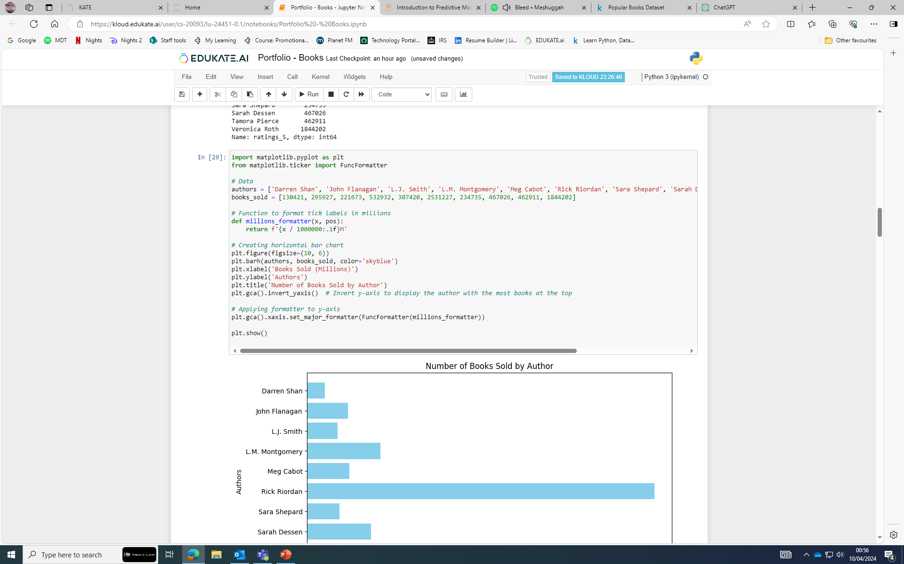
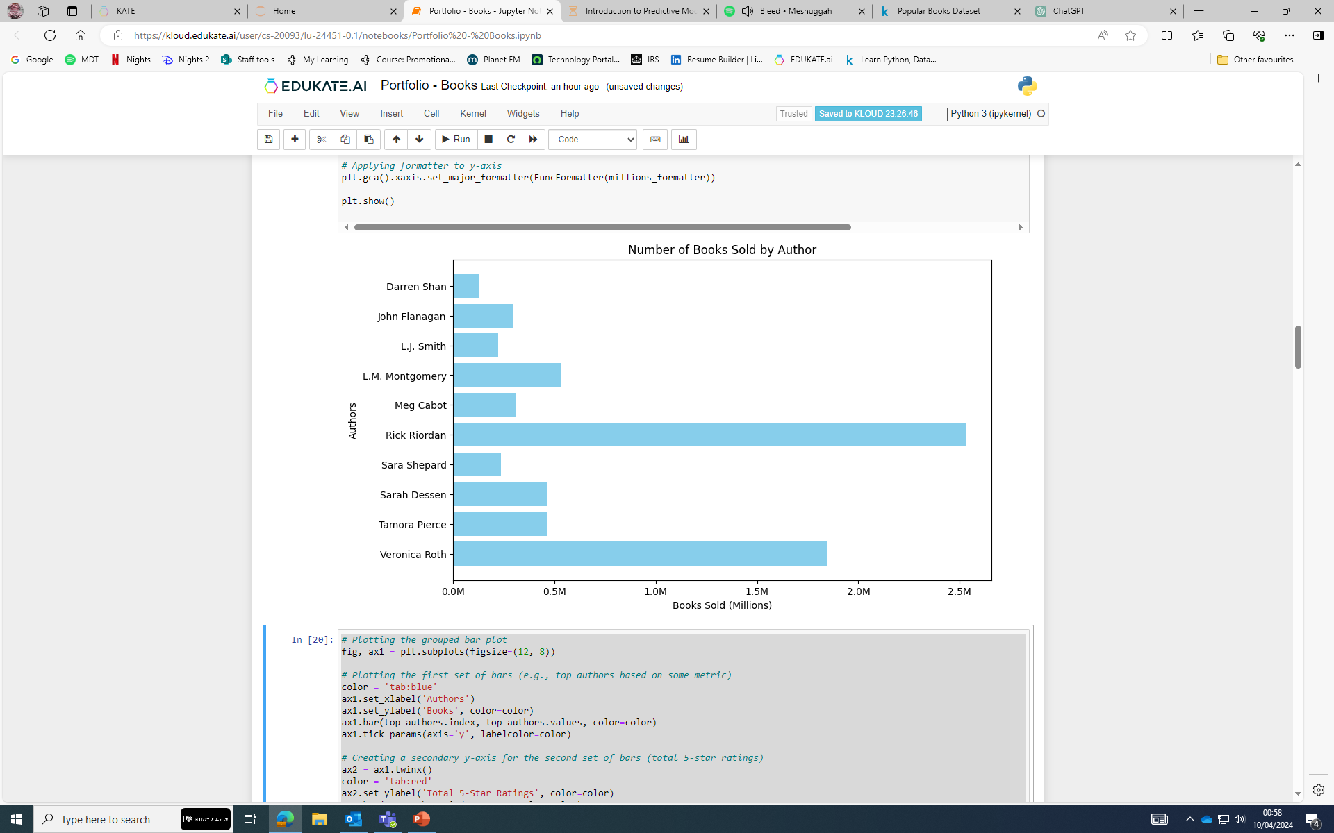
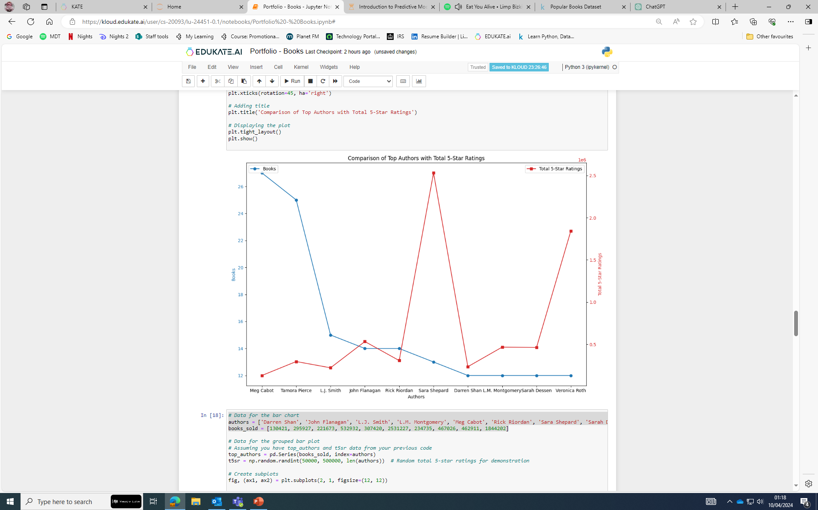
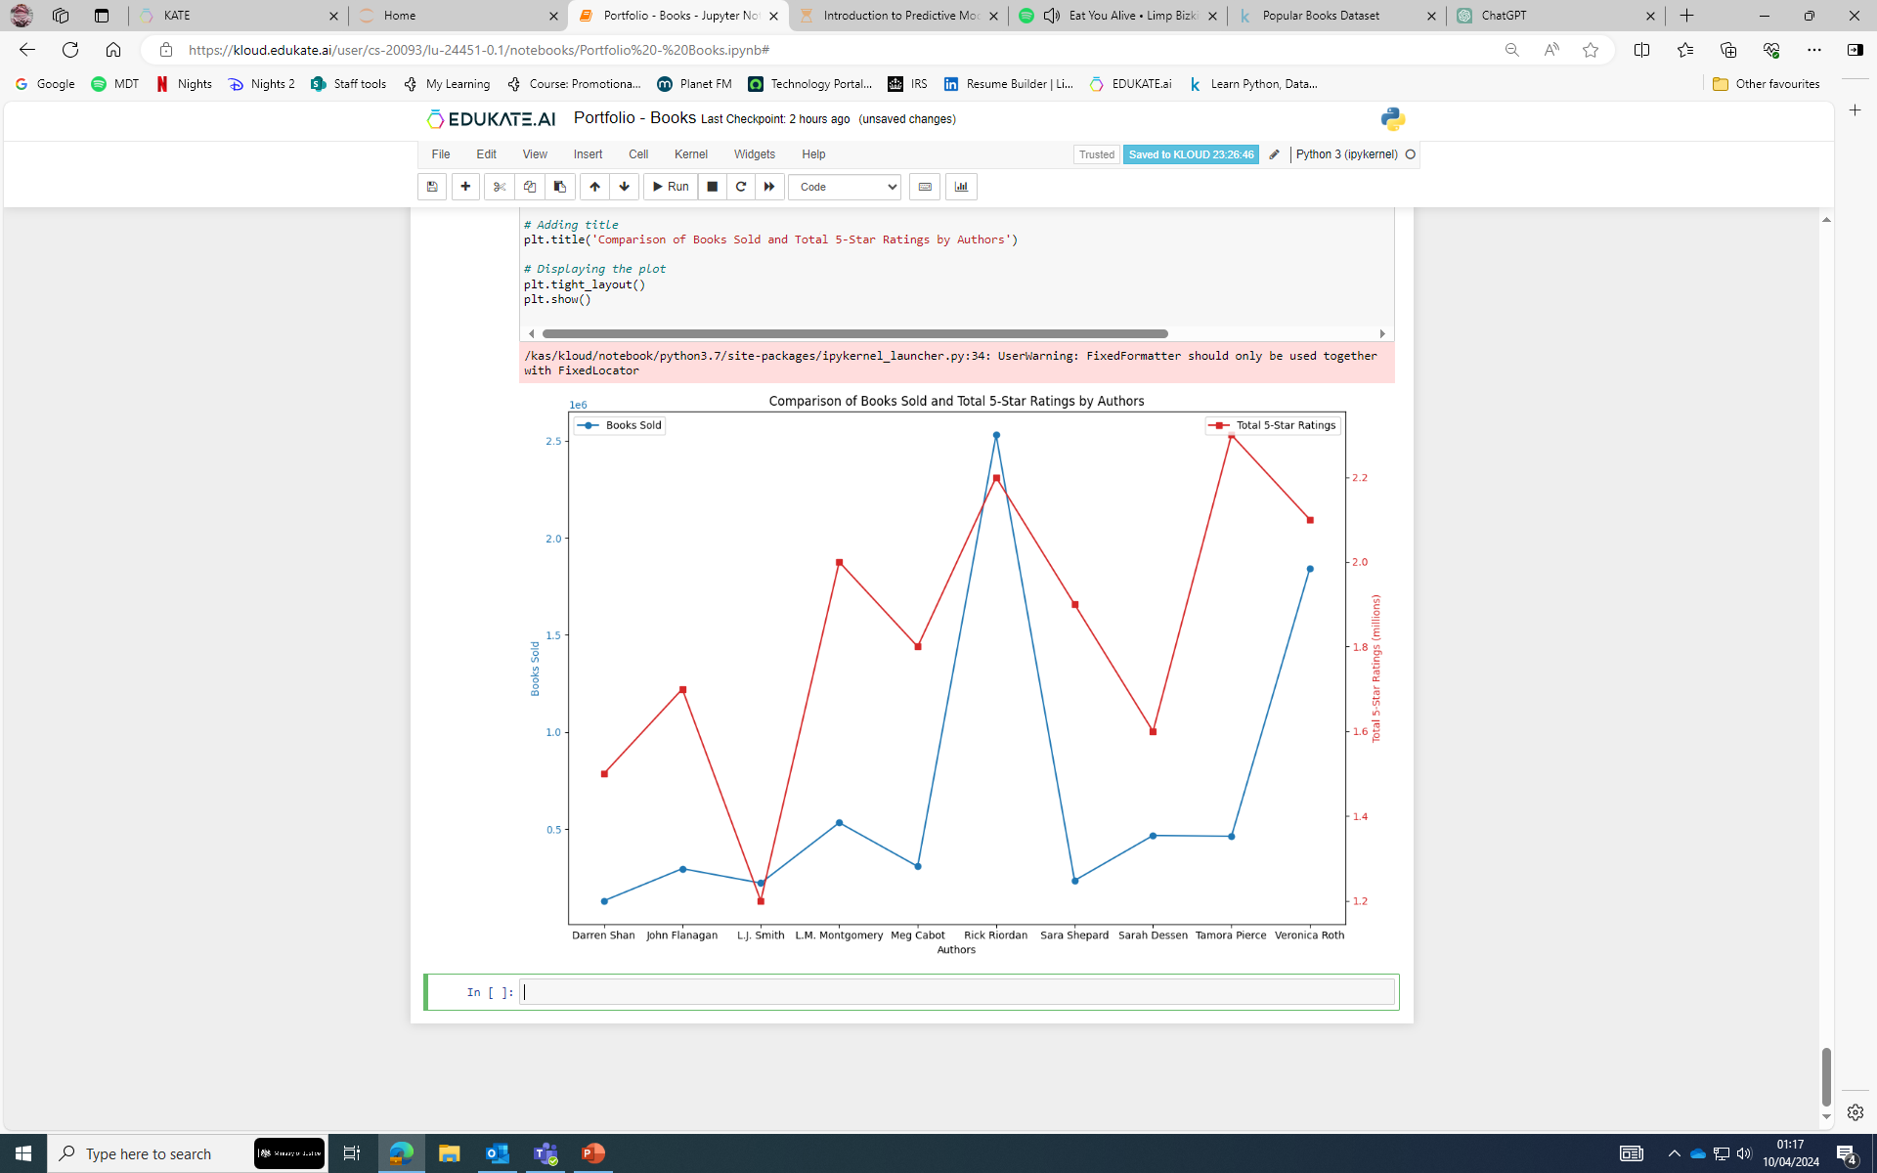
My next step was to filter the data frame, initially to show the top 10 from before then calculating the sum of the 5-star ratings for all their books, initially I thought that the person with the most books would also have the highest number of 5-star reviews, this was not the case.
From here I began trying to plot a correlation graph between books sold by author and number of 5-star reviews, this became challenging as there was an error in the data frame which required a workaround to display correctly.
This ended up becoming tiresome as the data
would not show correctly, therefore I then
started looking at using scatter graphs to
better display my data.
Portfolio Data Project 1 - Books

Slide 8
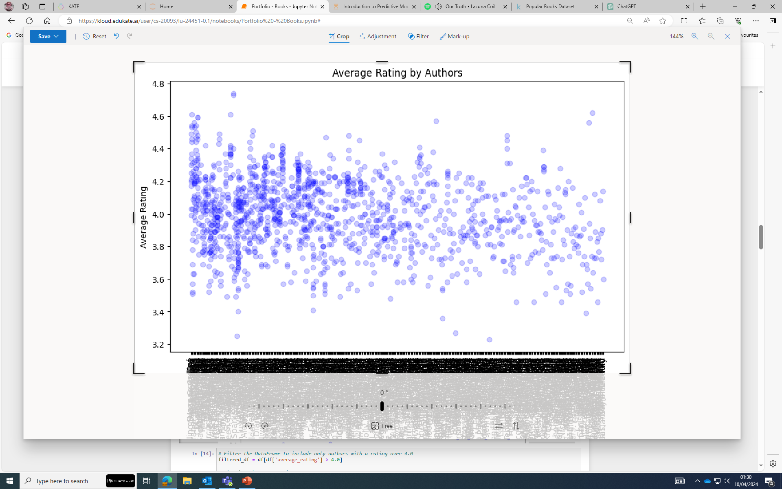
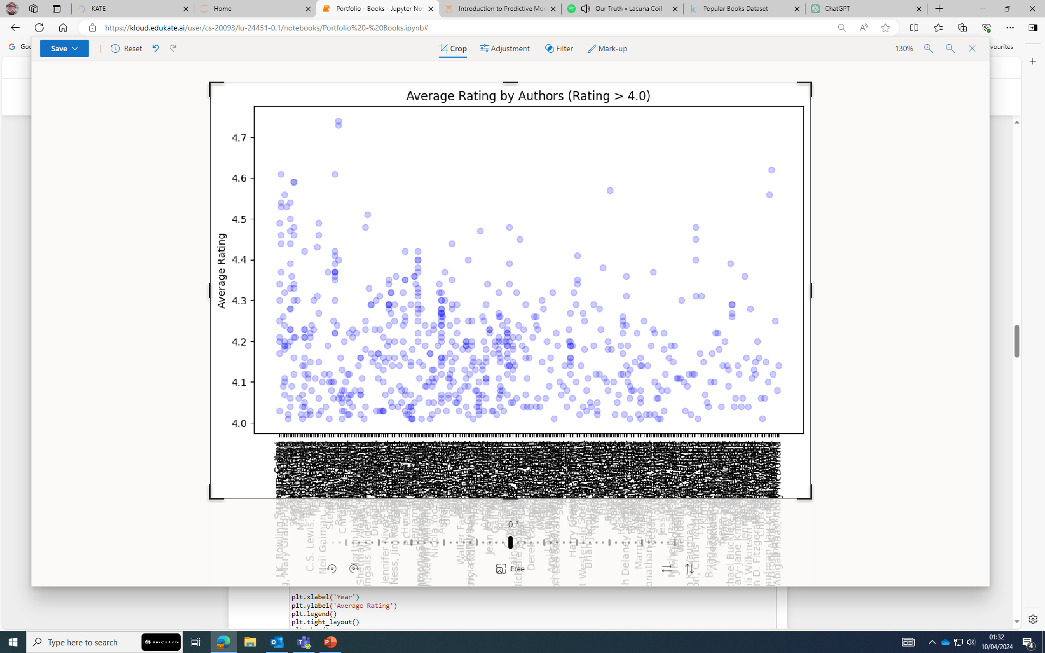
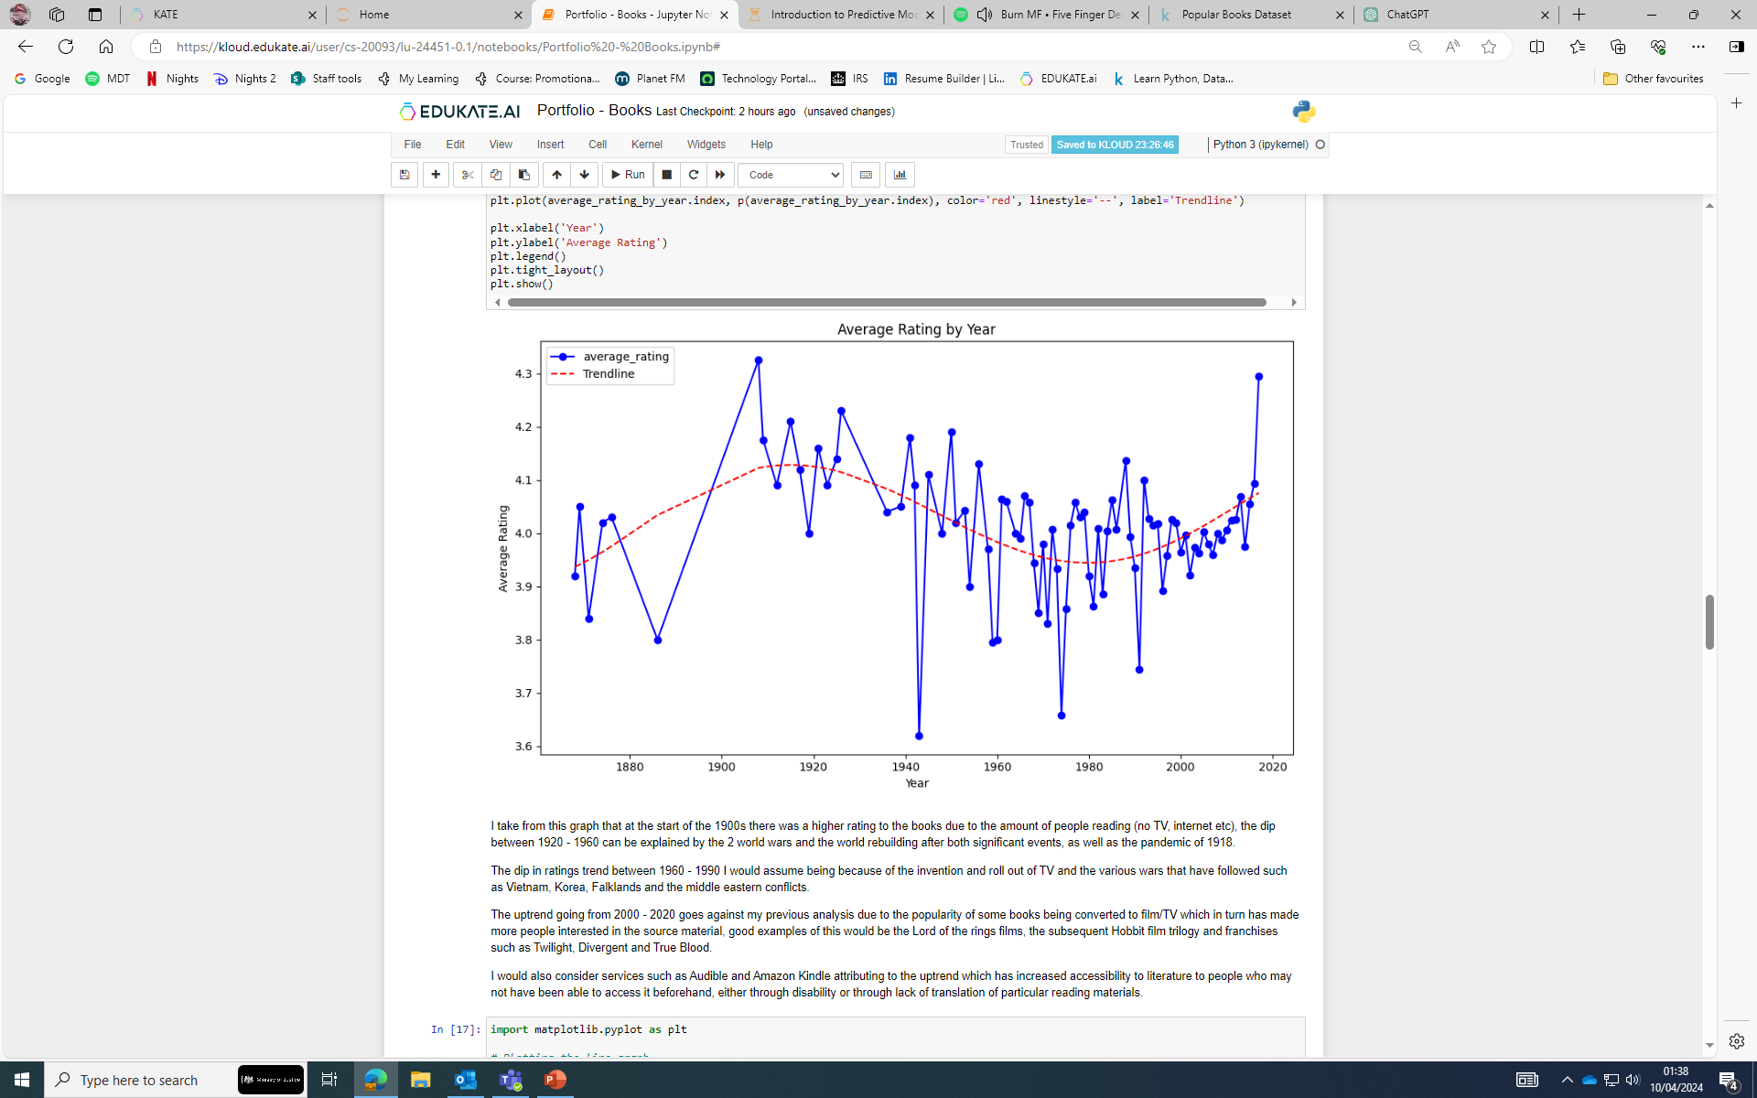
I began by filtering the DF so that I was only using entries that had an average rating of over 3, this was because of the amount of data and if I truly wanted to see the best values, higher seemed better.
I then changed this to anything over 4 as the data
For authors was incredibly long for an axis.
This appeared to be a dead end for displaying more
than a top 10 – 15 which would have skewed the
data far too much, I then had an idea…
I decided to display data showing the year of release against the average rating of books for that period and set a trend to show the popularity of books over a period of time.
This showed a lot of promise and gave me a better angle of what
to analyse with the data, I had.
Portfolio Data Project 1 - Books

Slide 9
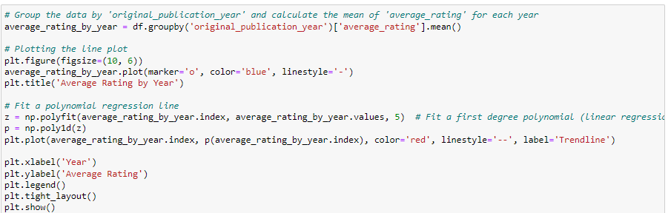
I take from this graph that at the start of the 1900s there was a higher rating to the books due to the amount of people reading (no TV, internet etc), the dip between 1920 - 1960 can be explained by the 2 world wars and the world rebuilding after both significant events, as well as the pandemic of 1918.
The dip in ratings trend between 1960 - 1990 I would assume being because of the invention and roll out of TV and the various wars that have followed such as Vietnam, Korea, Falklands and the middle eastern conflicts.
The uptrend going from 2000 - 2020 goes against my previous analysis due to the popularity of some books being converted to film/TV which in turn has made more people interested in the source material, good examples of this would be the Lord of the rings films, the subsequent Hobbit film trilogy and franchises such as Twilight, Divergent and True Blood.
I would also consider services such as Audible and Amazon Kindle attributing to the uptrend which has increased accessibility to literature to people who may not have been able to access it beforehand, either through disability or through lack of translation of reading materials.
Portfolio Data Project 1 - Books

Slide 10
There is a correlation between how popular an author is and how many books they have published, this is seen by the number of books sold and how many high ratings the author has.
There is a correlation between how unpopular an author is and how many books they have published.
Outliers in this data occur when multiple authors have contributed to a single book or in what I would assume to be an anthology.
There is a trend of how popular books are over the number of years in the data.
The high popularity of books in the early 20th century are attributed to the lack of other forms of entertainment such as Television and Video games, which ultimately lowers as these devices were invented and formed other means of entertainment.
This trend also shows in the early 21st century rising until the present, This is more likely due to the converting of books into Television, Film and online novels or other easily accessible formats such as Audible and Kindle which provide much more accessibility to people who otherwise would not have access.
It is my assessment that books remain popular even in the modern age due the ease of access worldwide and the less cumbersome ways of storage thanks to digitisation, with multiple translations available over the internet so stories can be shared in a much easier way.
Conclusion

Slide 11

Data Project 2
CardioGoodFitness

Slide 12
Agenda
The market research team have been assigned the task of investigating differences across product lines with respect to customer characteristics.
Product Data
Product Usage and Gender gap
Income Data
Correlation of data interpreted by the team
Conclusion
Portfolio Data Project 2 - CardioGoodFitness
Notes:
Our agenda for the presentation is as follows:
The market research team have been assigned the task of investigating differences across product lines with respect to customer characteristics.
For this presentation I will solely be working with the following datasets:
Product data
Product Usage and Gender gap
Income Data
Correlation of data interpreted by the team
Conclusion of findings and questions at the end.

Slide 13
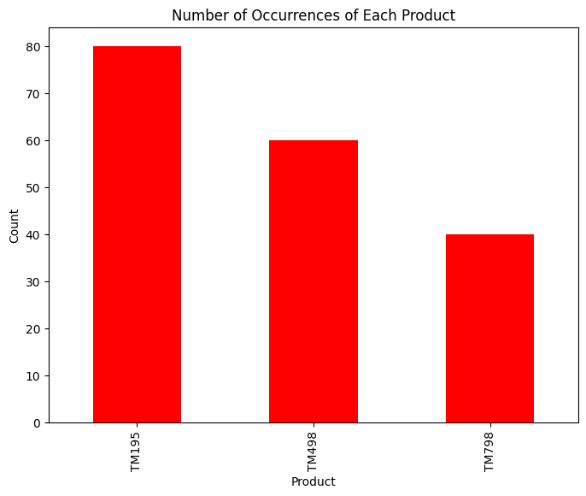
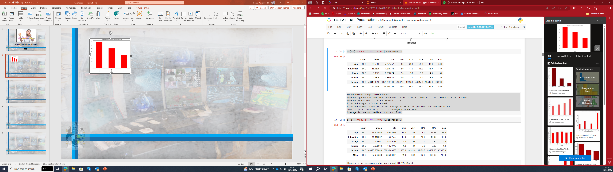
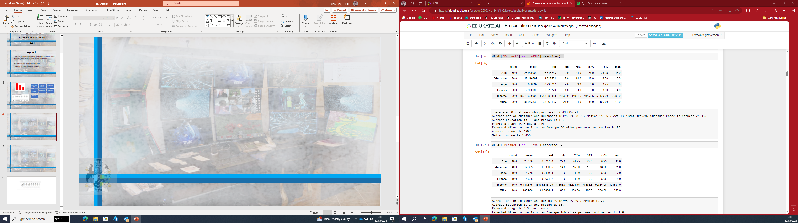
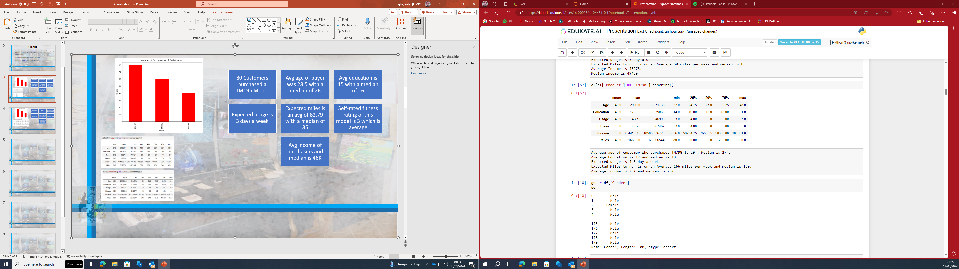
Product Data
80 customers bought TM195 model, this is 44.4% of total sales and makes the TM195 the most popular model
Average age of customer who purchases TM195 is 28.5, Median is 26 .
Average Education is 15 and median is 16.
Expected usage is 3 day a week.
Expected Miles to run is on an Average 82.78 miles per week and median is 85.
Self-rated fitness is 3 that is an average fitness level.
Average income and median is around $46K.
There are 60 customers who purchased TM 498 Model, this is 33% of total sales and the second most popular model.
Average age of customer who purchases TM498 is 28.9 , Median is 26, Customer range is between 24-33.
Average Education is 15 and median is 16.
Expected usage is 3 day a week.
Expected Miles to run is on an Average 60 miles per week, median is 85.
Average Income is 48973.
Median Income is 49459
Average age of customer who purchases TM798 is 29 , Median is 27 , there are outliers in this data.
Average Education is 17 and median is 18, suggesting a higher level of education.
Expected usage is 4-5 day a week which is the highest usage between the models.
Expected Miles to run is on an Average 166 miles per week and median is 160.
Average Income is 75K and median is 76K, which probably explains why it accounts for only 22% of total sales.
Portfolio Data Project 2 - CardioGoodFitness
Notes:
As we see the graph shows quite plainly that the TM195 model was the best seller this is probably due to the price which I believe is the cheapest option offered by CardioGoodFitness
This model makes up 44.4% of total sales this is almost half of all sales.
Average age = 28.5 median of 26, Average education is 15 and median 16.
Expected usage is 3 days a week with an expected mileage of 82.78 on average.
Income expectations of most purchasers is around $46K
The TM498 is the second most popular model which accounts for a third of total sales
The customer age range for this model is similar the TM195 and sits between 24 – 33 years old with an average education of 15
The TM498 has on average a lower mileage per week at 60 but the median of the data shows 85 which mirrors the TM195.
Income expectations of customers of this model isn’t much higher than the TM195 which sits at $48.9K on average
The last model which is assessed at being the most expensive of the treadmill range is the TM798
This is the least popular model but surprisingly has a higher usage data than the two previous models.
Expected usage is considerably higher at 4-5 days as an average and the milage is double the other two models
Income expectations of customers for this model is $76K and probably explains the 22% of total sales.

Slide 14
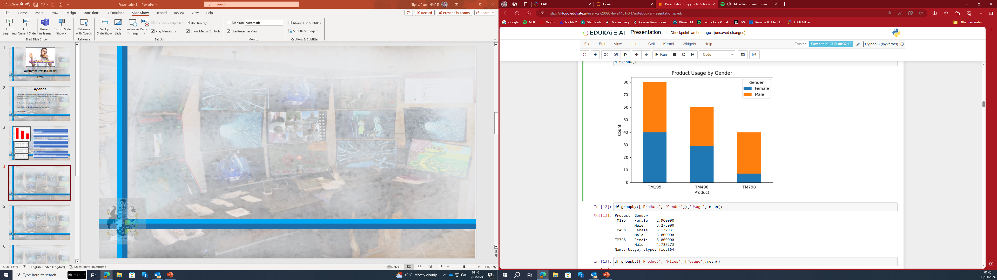
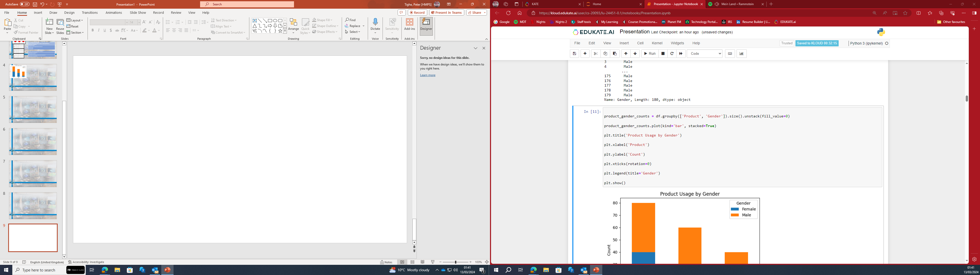
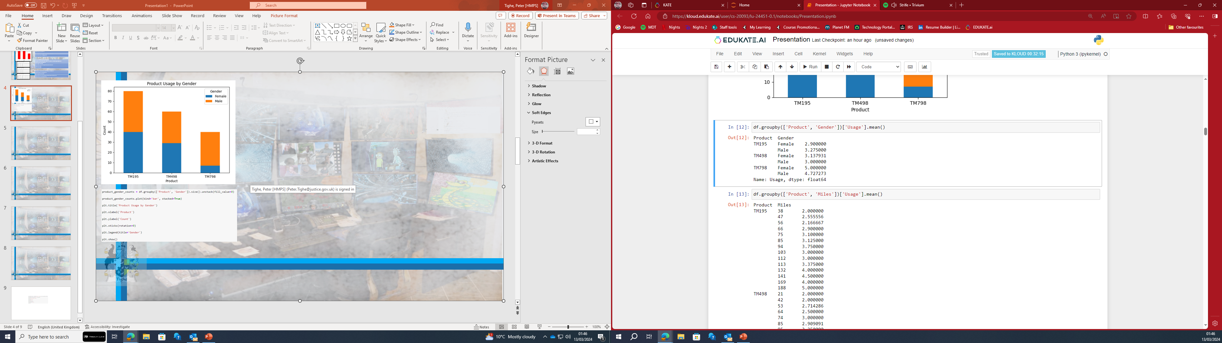
Gender Usage
There are 76 Female and 104 Male customers. More Male customers are buying treadmills compared to Female customers.
Male customers make up 57.8% of all sales and Female customers 42.2%.
The TM195 model is more popular with both genders as an even split of 40 orders each.
The TM498 is almost evenly split with Male customers purchasing 31 and Female customers purchasing 29.
The TM798 model is more popular with male customers and is the most uneven split of all models with Female customers only purchasing 7 whilst Male customers bought 33.
This equates to Male customers buying 82.5% of the most expensive model and only 17.5% bought by Female customers
The average age of customers was 28.5 for Female customers and 28.9 for Male customers
Male customers have a higher self-rated fitness
Expected Usage and miles covered on tread mill is less in Female customers than male customers.
Notes:
Our next dataset is Gender.
The bar graph shows that for the TM195 and 498 there is very little in a gender gap for purchases of both machines, overall Male customers account for 57.8% of total sales.
The TM798 however has an enormous gender gap with only 7 customers being Female, this equates to Male customers making up 82 and a half % of total sales of the most expensive model.
Male customers have a higher self-rated fitness and expected usage and miles covered on tread mill is less in Female customers than male customers.
Overall, there are 76 Female customers and 104 Male customers for our treadmills, with an average age of 28.

Slide 15
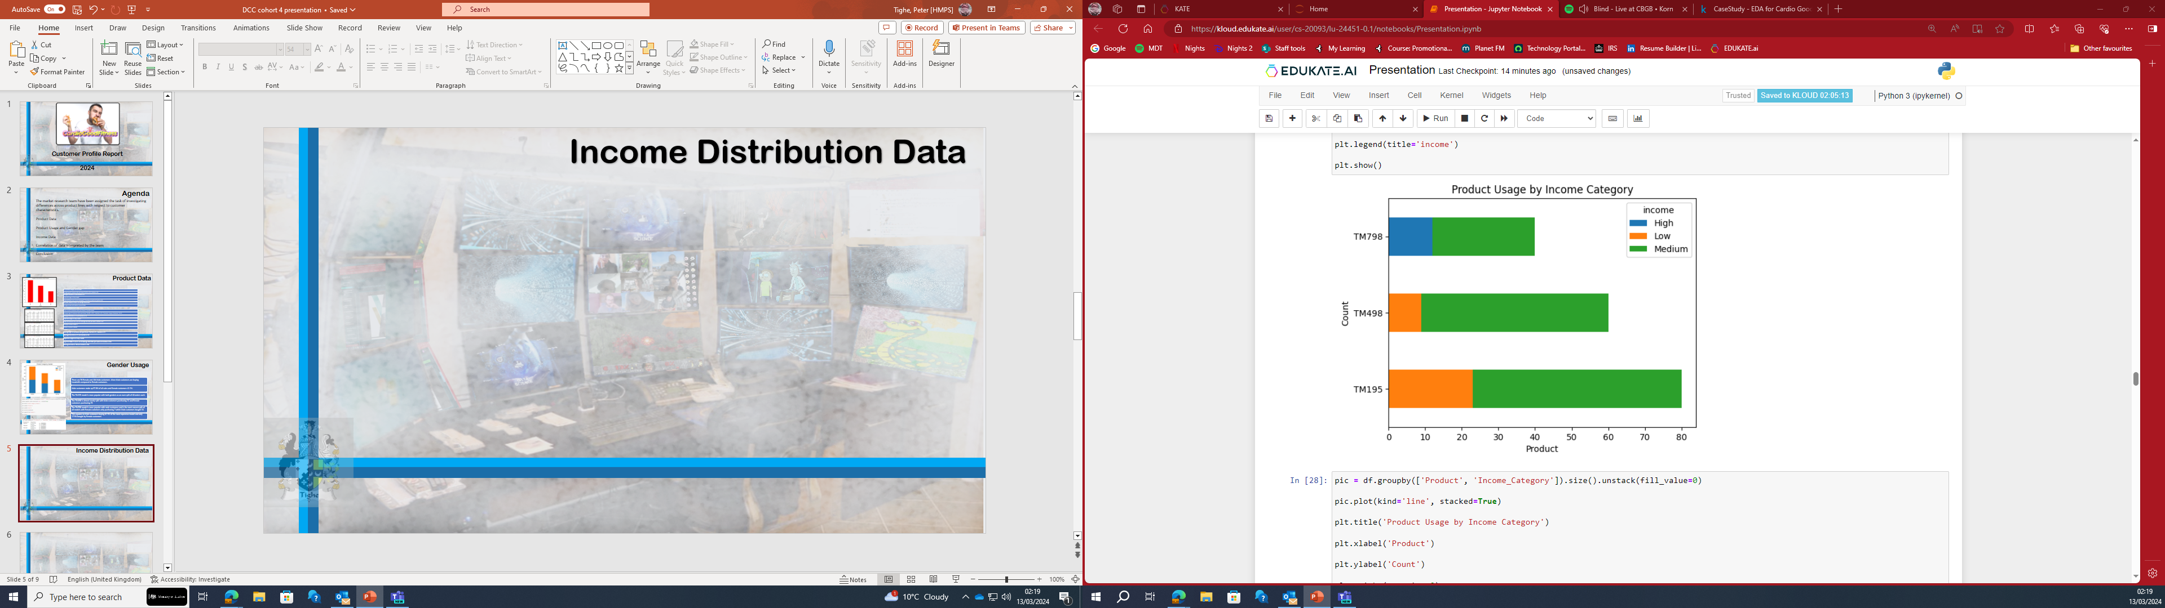
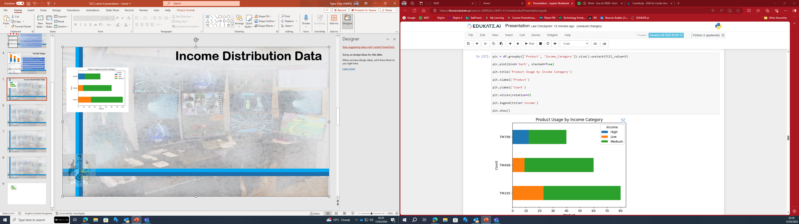
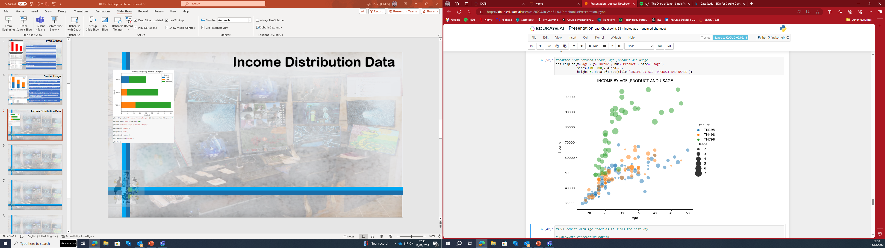
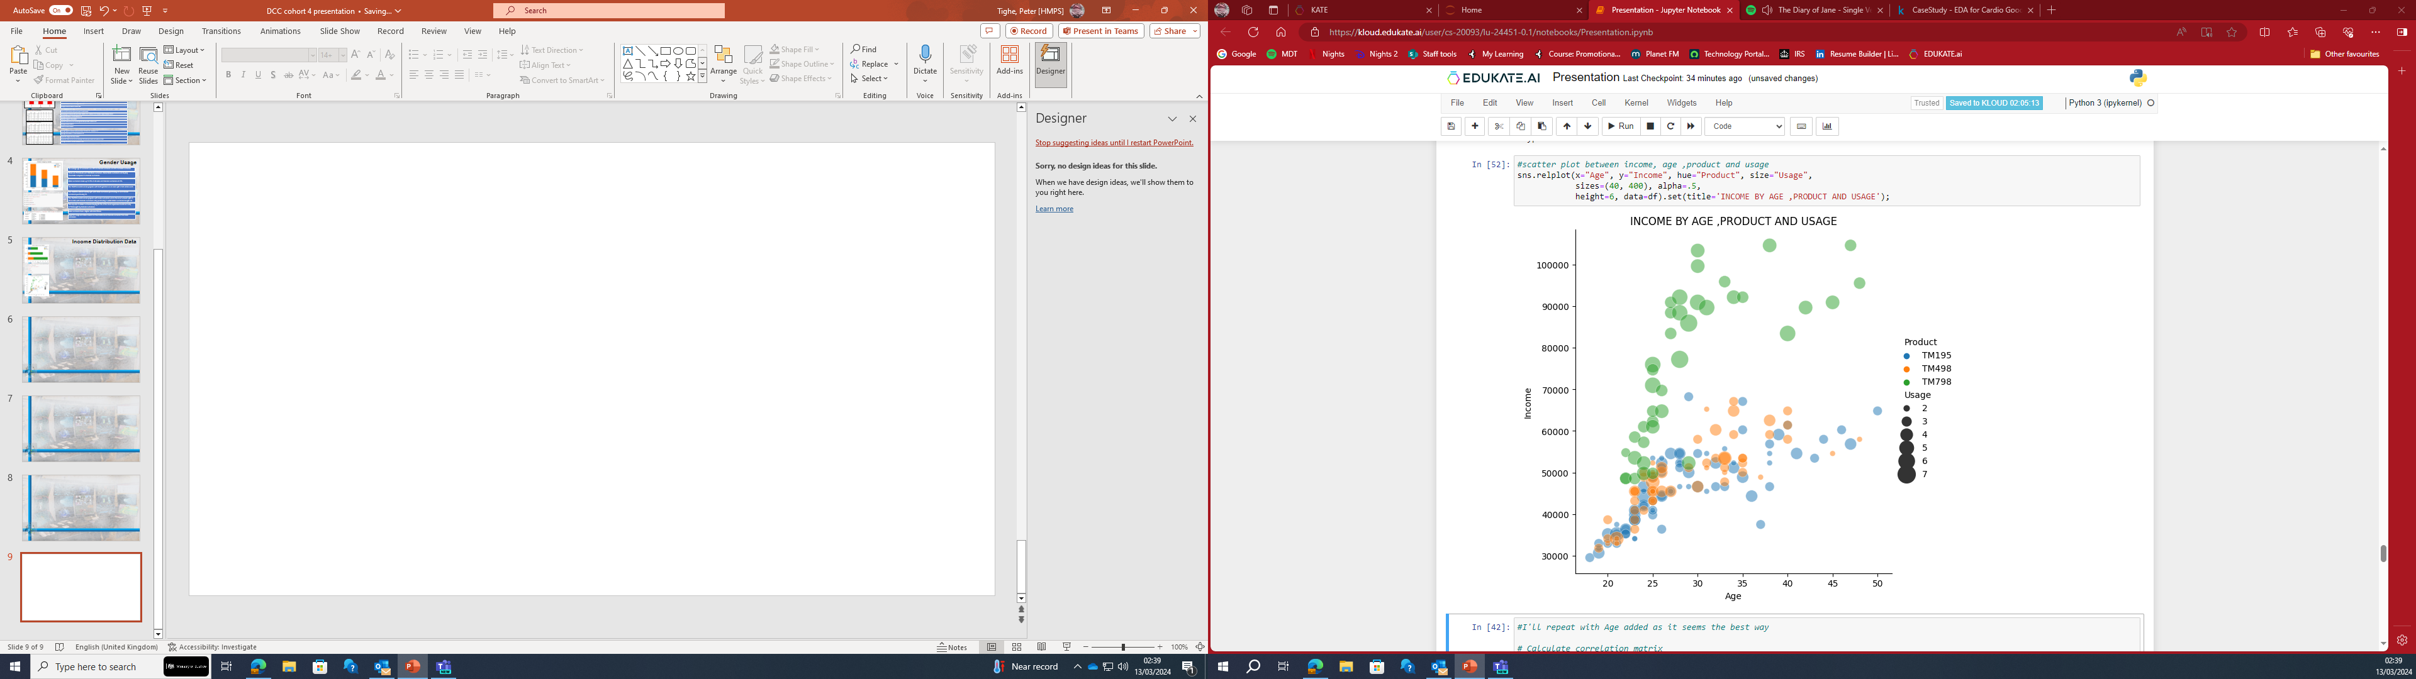
Income Distribution Data
Products TM195 and TM498 are bought by people with lower than 70K as income and age is concentrated more in range of 23-35.
Product TM798 is mainly bought by people with higher than 70K income and age falls in range of 23-30. -Majority of people who buys the TM798 expect that they will run more than consumers of the other two products, on average.
Most of the customers are in lower pay range and earn less than 40K.
The main consumers fall into the medium income bracket, this was set at 40k – 60k this correlates with the Mean $55K, Median $50K, and Mode $45K
Income has some outliers in the data, few customers earn higher than $80K
TM195 & TM498 attracts people with income less than 60k , may be because of the cost of both models.
TM798 should be marketed as a high-end treadmill for professionals and athletes.
Portfolio Data Project 2 - CardioGoodFitness
Notes:
My last dataset before the correlation is income distribution data
Maximum income of treadmill user is 100K , Average income approx. 54K ,while median is approx $51K
Products TM195 and TM498 are bought by people with lower than 70K as income and age is concentrated more in range of 23-35.
The main consumers fall into the medium income bracket, this was set at 40k – 60k this correlates with the Mean $55K, Median $50K, and Mode $45K
TM798 should be marketed as a high-end Treadmill for professionals and athletes.
TM195 & TM498 attracts people with income less than 60k , may be because of the cost of both models. We should market these models as a budget Treadmill for all.
The dataset has a few outliers, mainly as the income above 80K has so few data points.

Slide 16
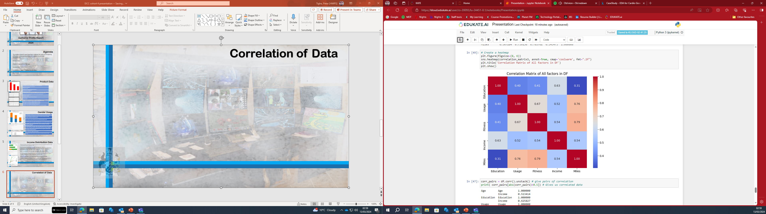
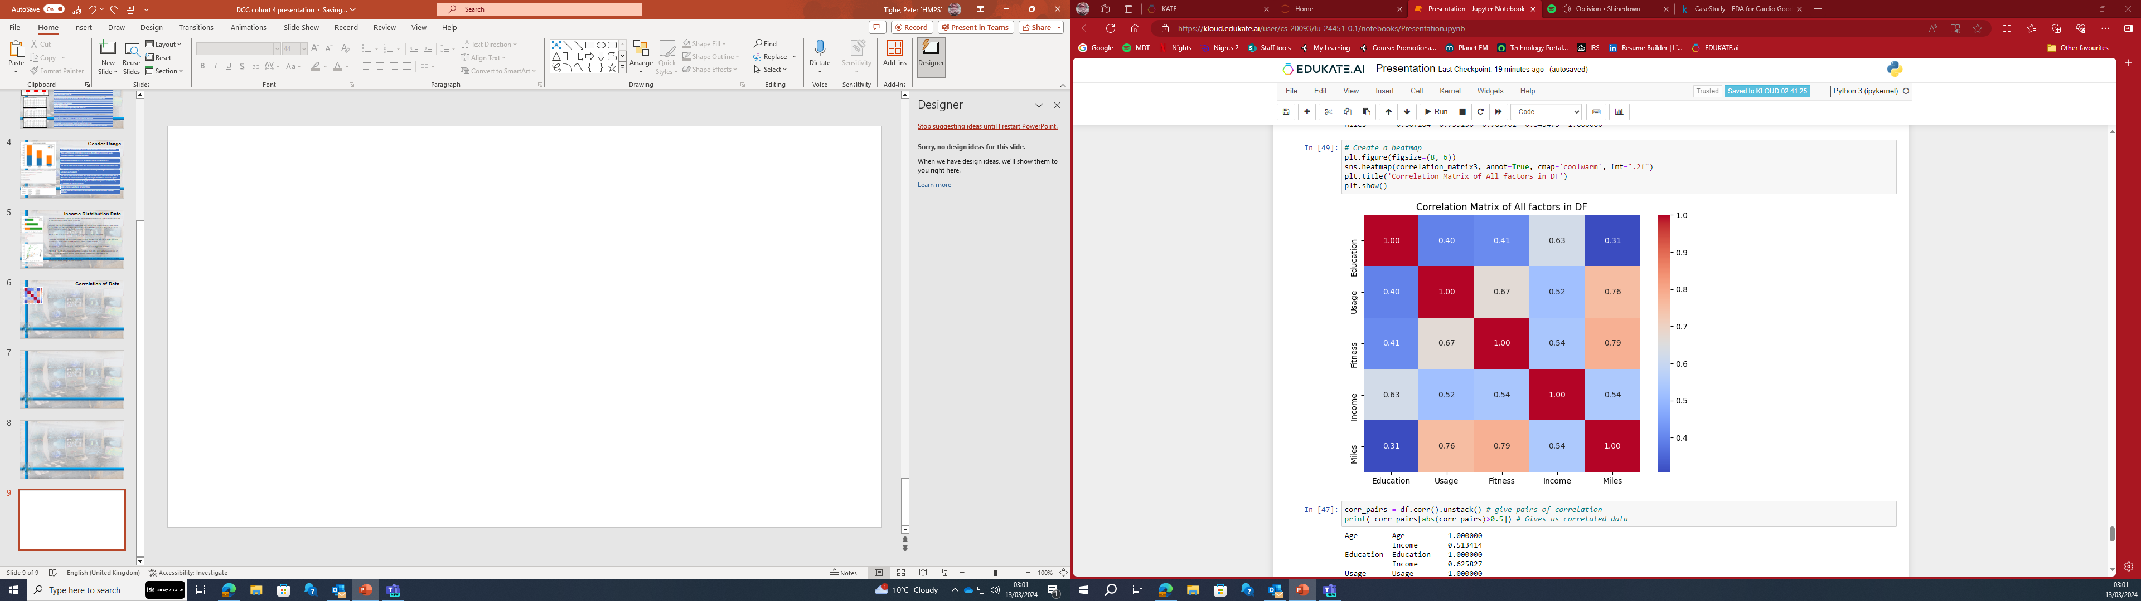
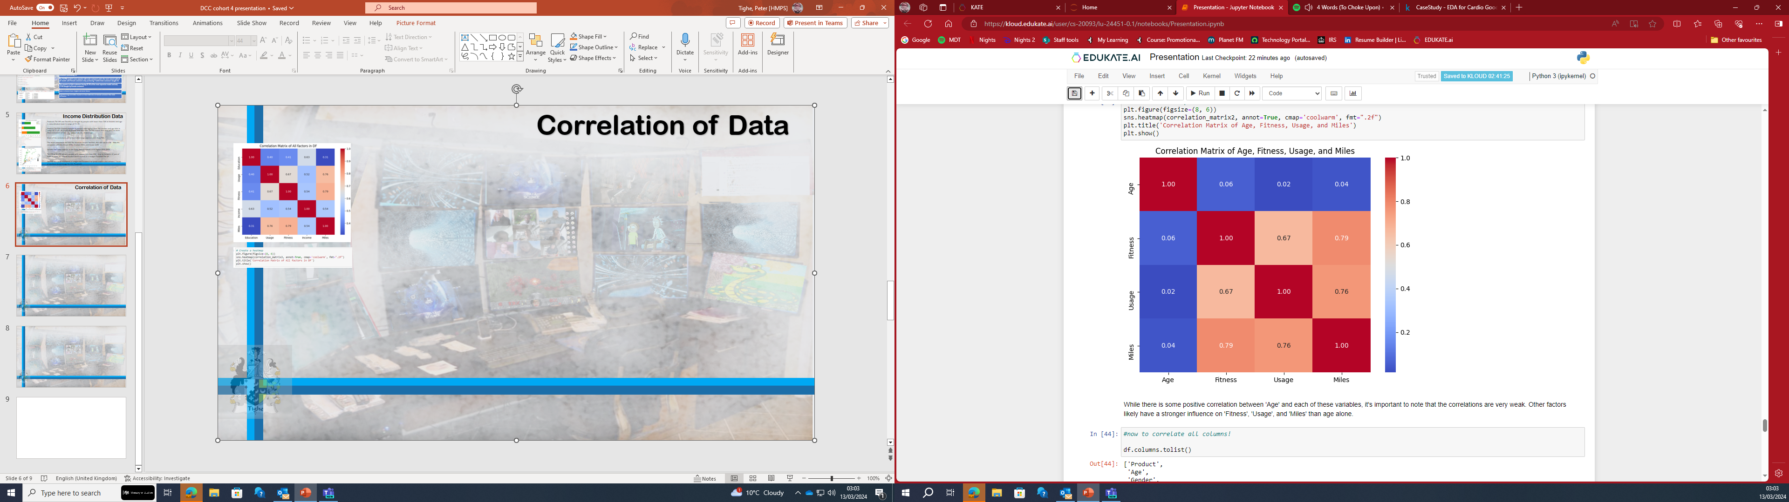
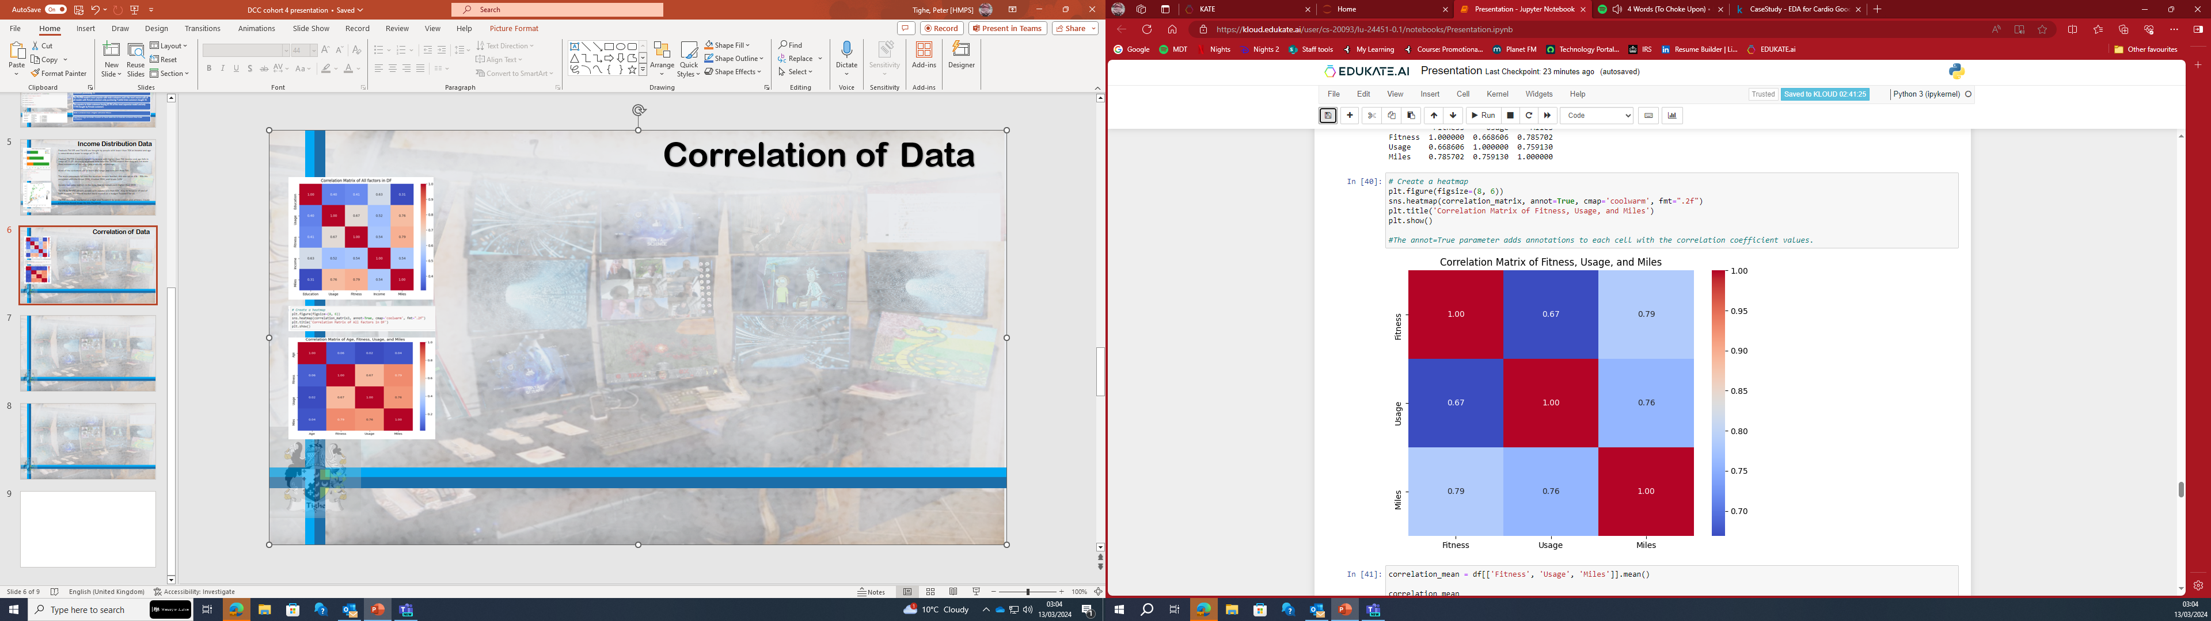
Correlation of Data
This correlation matrix represents the correlation coefficients between different variables
Education: It shows a moderate positive correlation with Income (0.626), Usage (0.395), Fitness (0.411), and Miles (0.307).
Usage: There's a strong positive correlation between Usage and both Fitness (0.669) and Miles (0.759). It also has moderate positive correlations with Education (0.395) and Income (0.520).
Fitness: Similar to Usage, Fitness has a strong positive correlation with both Usage (0.669) and Miles (0.786). It also has a moderate positive correlation with Education (0.411) and Income (0.535).
Income: Income shows moderate positive correlations with Education (0.626), Usage (0.520), Fitness (0.535), and Miles (0.543).
Miles: Miles has a strong positive correlation with both Usage (0.759) and Fitness (0.786). It also has moderate positive correlations with Education (0.307) and Income (0.543).
Overall, from this correlation matrix, we can see that Usage, Fitness, and Miles are highly interrelated, which is intuitive as they are all related to physical activity. Education and Income also show significant positive correlations with various other variables, suggesting potential relationships between socioeconomic status, education level, and fitness-related behaviours. However, correlation does not imply causation, so further analysis would be needed to understand the underlying relationships.
While there is some positive correlation between 'Age' and each of these variables, it's important to note that the correlations are very weak. Other factors have a stronger influence on 'Fitness', 'Usage', and 'Miles' than age alone.
Notes:
This correlation matrix represents the correlation coefficients between different variables:
Education: It shows a moderate positive correlation with Income (0.626), Usage (0.395), Fitness (0.411), and Miles (0.307).
Usage: There's a strong positive correlation between Usage and both Fitness (0.669) and Miles (0.759). It also has moderate positive correlations with Education (0.395) and Income (0.520).
Fitness: Similar to Usage, Fitness has a strong positive correlation with both Usage (0.669) and Miles (0.786). It also has a moderate positive correlation with Education (0.411) and Income (0.535).
Income: Income shows moderate positive correlations with Education (0.626), Usage (0.520), Fitness (0.535), and Miles (0.543).
Miles: Miles has a strong positive correlation with both Usage (0.759) and Fitness (0.786). It also has moderate positive correlations with Education (0.307) and Income (0.543).
Overall, from this correlation matrix, we can see that Usage, Fitness, and Miles are highly interrelated, which is intuitive as they are all related to physical activity. Education and Income also show significant positive correlations with various other variables, suggesting potential relationships between socioeconomic status, education level, and fitness-related behaviours. However, correlation does not imply causation, so further analysis would be needed to understand the underlying relationships.
While there is some positive correlation between 'Age' and each of these variables, it's important to note that the correlations are very weak. Other factors have a stronger influence on 'Fitness', 'Usage', and 'Miles' than age alone.

Slide 17
Conclusion
Important Observations
44.4% customers brought TM195. TM195 model is the most purchased model. TM498 was purchased more than TM798.
57.8% male brought Treadmill. There are more Male customers than Female customers.
Average Usage of Males is more than Average usage of Females.
Customers buying treadmill are younger and average age of customer is 28, median is 26 and mode is 25
Most of the customers are in lower pay range and earn less than 70K.
Average Education is 16 and median is 18.
Customer Profiles of Models
TM195
44.4% of all sales has come from this model. Majority of people whose income is around 55K has purchased this model assuming it’s because of its appealing price and affordability. Equal number of males and females bought this model suggesting this model is not gender specific. Customers who bought this treadmill believe their fitness is average and might be looking for a basic treadmill that does the job.
TM498
Sale was 33%.This was the 2nd most sold model. The income of this group is almost same as TM195 model. TM498 model expecting to use Treadmill less frequently but to run more miles a week.
TM798 This treadmill seems to be more popular with customer having high income. This is costlier compared to the other two models. The TM798 may have some advanced features and people with high income are ready to spend more money to buy this model. Male customers who are more serious about fitness or professionals may buy this model. Customer's self-rated fitness is between 3 -5 and expected usage is more than 4 days, suggest they have been working out and might be looking for an upgrade from their existing treadmill model.
Portfolio Data Project 2 - CardioGoodFitness
Notes:
Important Observations
44.4% customers brought TM195. TM195 model is the most purchased model. TM498 was purchased more than TM798.
57.8% male brought Treadmill. There are more Male customers than Female customers.
Average Usage of Males is more than Average usage of Females.
Customers buying treadmill are younger and average age of customer is 28, median is 26 and mode is 25
Most of the customers are in lower pay range and earn less than 70K.
Customer Profiles of Models
TM195
Customers who bought this treadmill believe their fitness is average and might be looking for a basic treadmill that does the job.
TM498
Customers who bought TM498 model expecting to use Treadmill less frequently but to run more miles a week.
TM798 This treadmill seems to be more popular with customer having high income, Male customers who are more serious about fitness or professionals may buy this model. Customer's self-rated fitness is between 3 -5 and expected usage is more than 4 days, suggest they have been working out and might be looking for an upgrade from their existing treadmill model.

